Slide 1
UR3e <-> RGI14 connection

Slide 2
Mechanical interface

Slide 3
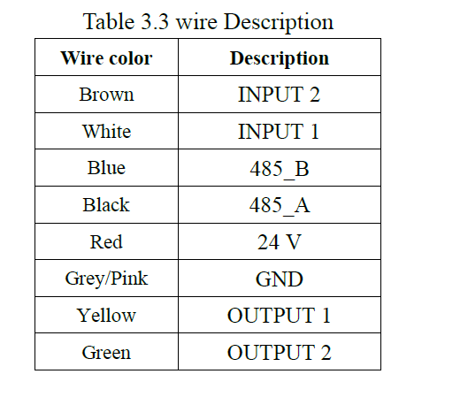
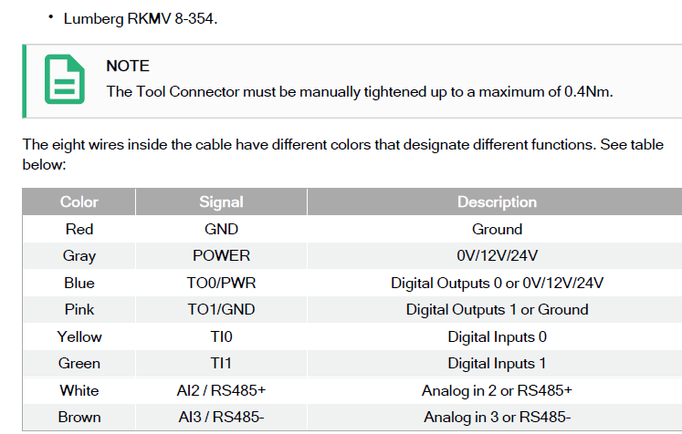
Electrical interfaces
RGI14 corrected
UR3e
Green
Black
Orange

Slide 4
Wire pairings
No. Wire-pairing | UR3e Lumberg RKMV 8-354 | UR3e description | RGI14 | RGI14
 | Color | Description | Color | Description
1 | Red | GND | BLACK | GND
2 | Gray | POWER (24V) | Red | 24V
3 | Blue | TO0:Digital Output 0 | White | Input 1
4 | Pink | TO1:Digital Output 1 | Brown | Input 2
5 | Yellow | TI0: Digital Input 0 | Yellow | Output 1
6 | Green | TI1: Digital Input 1 | Orange | Output 2
7 | White | RS485+ | Green | 485_A
8 | Brown | RS485- | Blue | 485_B

Slide 5
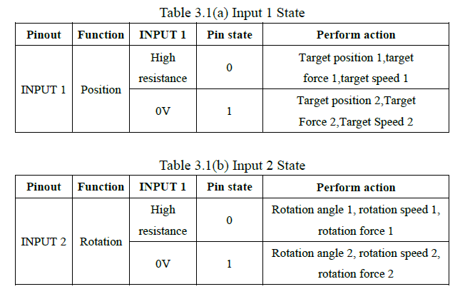
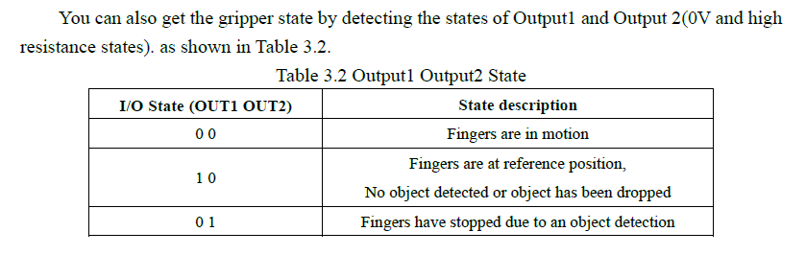
I/O control RGI14

Slide 6
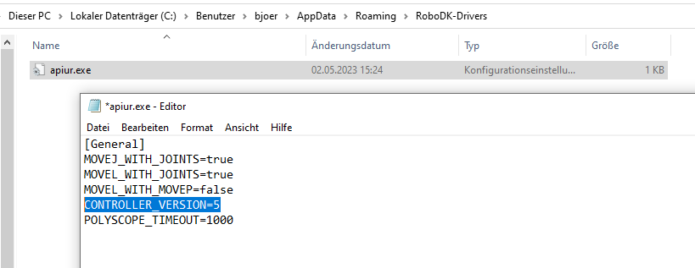
Settings in RoboDK for I/O control
https://robodk.com/forum/Thread-Controlling-UR-Tool-I-O

Slide 7
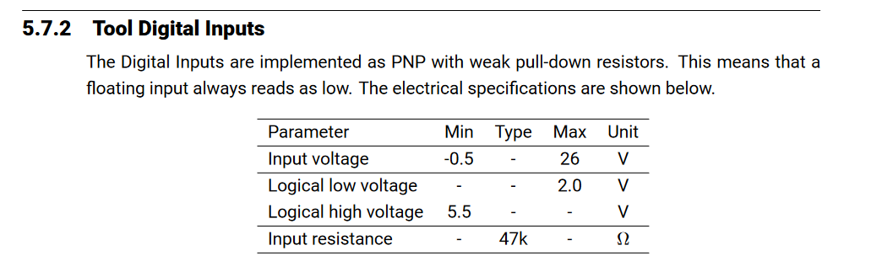

Slide 8
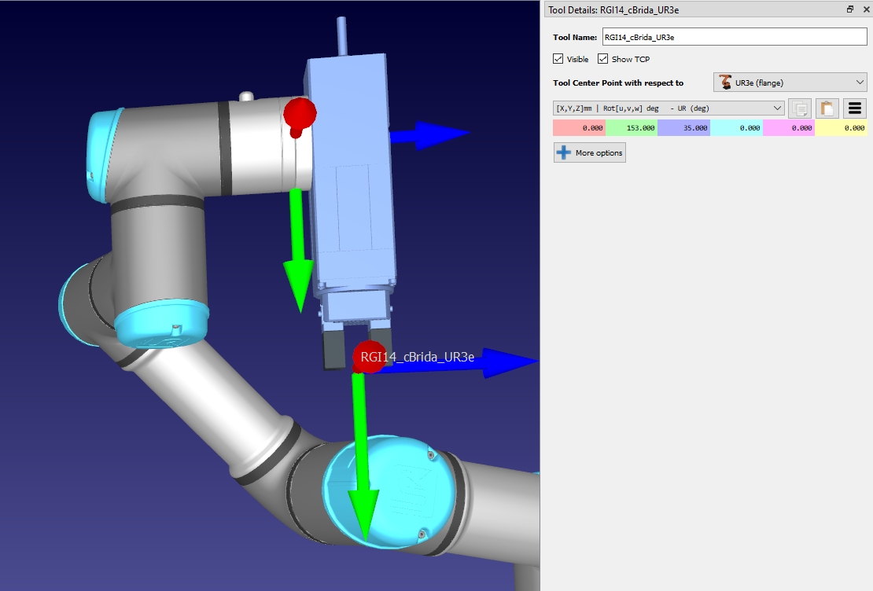
Set TCP in RoboDK

